Slide 1
Case Study: Modeling Self-Perceived Health and Longevity with SHARE Dataset
Калоян Тотев
Михаил Ангелов
Сергей Филипов

Slide 2
Outline
Introduction
Dataset
Aim
Charts
Methodology
Conclusions
Appendix
Results

Slide 3

a research infrastructure for studying the effects of health, social, economic and environmental policies over the life-course of European citizens and beyond.
9 waves from 2004 to 2021/2022
In Bulgaria – from the 7th wave (2018–)

Slide 4
Dataset
46733 observations
3540 variables
26 European countries + Israel

Slide 5
Aim
Self-Perceived Health how individuals rate their health
Age used as a proxy for longevity

Slide 6

Charts

Slide 7
Feature Selection
Remove predefined redundant and multicollinear columns (from two exclusion lists)
Replace all negative values with NaN (in numeric columns)
Drop columns with ≥70% missing values
Impute remaining missing numeric values with the median
Split features into 10 chunks and compute feature importance using a Decision Tree for each chunk
Select features
Notes:
Стартираме с голям масив – 46 733 реда и 3500 колони. (В началото на анализа работим с цялата таблица – 46 733 наблюдения и 3500 променливи.)
Премахваме колони с причинно-следствени връзки и тафтология от първи списък. (Първата стъпка е да изключим всички колони, които дублират информация или имат явна функционална зависимост с други.)
Премахваме и колони със силна мултиколинеарност от втори списък (VIF > 10). (Следва да отстраним колоните с висока мултиколинеарност, измерена с VIF над 10, които са идентифицирани извън този скрипт.)
Заменяме всички отрицателни стойности с NaN само в числовите колони. (Всички отрицателни стойности в числовите променливи ги преобразуваме в липсващи данни.)
Премахваме колони с поне 70% липсващи стойности. (Премахваме всяка колона, в която липсват повече от 70% от стойностите.)
Импютираме останалите липсващи стойности с медиана в числовите колони. (Попълваме останалите липсващи стойности в числовите колони с медианата на съответната колона.)
Премахваме редове с липсваща стойност в таргет променливата. (Филтрираме всички наблюдения, за които няма налична стойност на таргет променливата.)
Разделяме колоните на 10 чънка за анализ на feature важност. (Поради големия брой колони, ги разделяме на 10 групи, така че всеки чънк да може да се обработи лесно.)
За всеки чънк: енкодираме категориалните променливи и изчисляваме feature importance с Decision Tree. (Във всеки чънк категоричните колони се кодират, и чрез Decision Tree определяме кои променливи са важни за таргета.)
Събираме всички важни feature-и от всеки чънк и ги обединяваме. (Съставяме финален списък с важни колони, които имат важност над 0.01.)
Слепваме обработените чънкове и махаме дублиращите се колони. (Всички чънкове се обединяват обратно, като елиминираме повторенията между колоните.)
Финалният масив съдържа само важните feature-и и таргета, с размер 46 733 реда и 198 колони. (Крайният резултат е много по-компактен масив – 198 колони, като броят на редовете остава непроменен.)

Slide 8

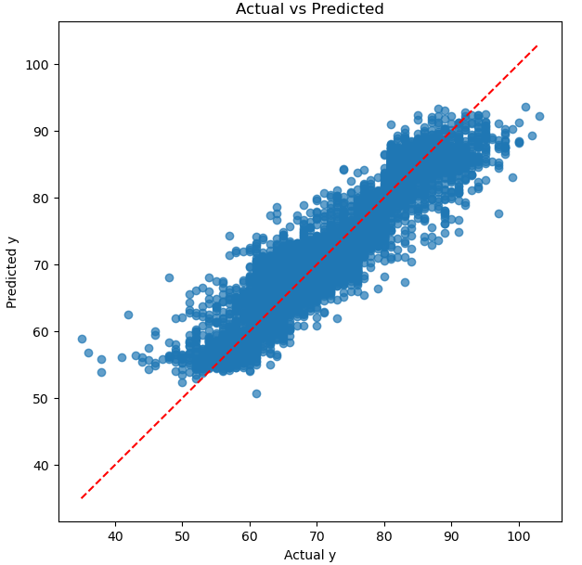
The data is split into 80% training and 20% test sets.
TEST set MAE: 2.534
TEST set MAPE: 3.62%
TEST set R²: 0.871
TEST set Adjusted R²: 0.868
TRAIN set MAE: 2.489
TRAIN set MAPE: 3.56%
TRAIN set R²: 0.878
TRAIN set Adjusted R²: 0.878

Slide 9
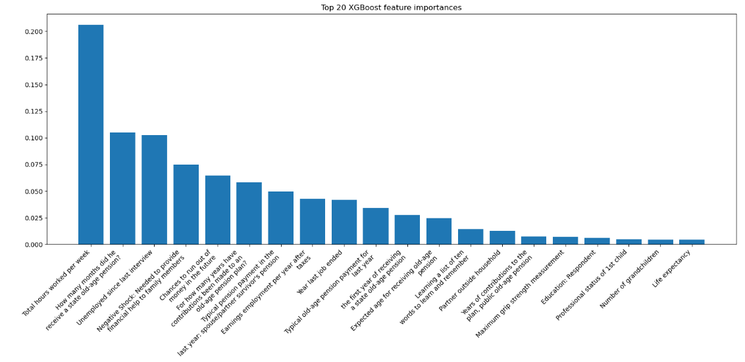
Notes:
Тежестта (feature importance) на всяка характеристика се изчислява като средния принос на тази характеристика към подобряването на разделянията във всички дървета на XGBoost модела. По-висока стойност = по-важен feature.
Top 20 feature importances: Total hours worked per week: Importance 0.2060 How many months did he receive a state old-age pension?: Importance 0.1052 Unemployed since last interview: Importance 0.1023 Negative Shock: Needed to provide financial help to family members: Importance 0.0749 Chances to run out of money in the future: Importance 0.0645 For how many years have contributions been made to an old-age pension plan?: Importance 0.0584 Typical pension payment in the last year: spouse/partner survivor's pension: Importance 0.0497 Earnings employment per year after taxes: Importance 0.0425 Year last job ended: Importance 0.0417 Typical old-age pension payment for last year: Importance 0.0342 the first year of receiving a state old-age pension: Importance 0.0274 Expected age for receiving old-age pension: Importance 0.0248 Learning a list of ten words to learn and remember: Importance 0.0143 Partner outside household: Importance 0.0127 Years of contributions to the plan, public old-age pension: Importance 0.0074 Maximum grip strength measurement: Importance 0.0068 Education: Respondent: Importance 0.0060 Professional status of 1st child: Importance 0.0049 Number of grandchildren: Importance 0.0045 Life expectancy: Importance 0.0045

Slide 10
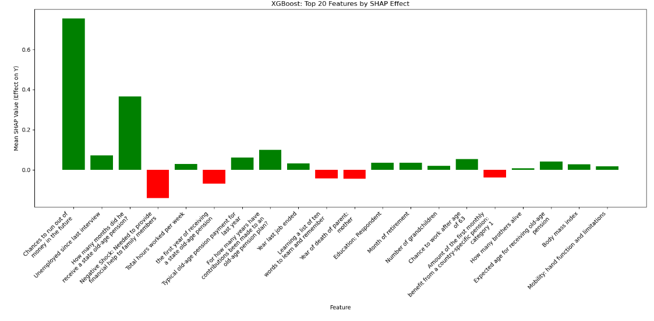
Notes:
Top 20 SHAP features by mean effect: Chances to run out of money in the future: Mean SHAP Value 0.7550 Unemployed since last interview: Mean SHAP Value 0.0716 How many months did he receive a state old-age pension?: Mean SHAP Value 0.3660 Negative Shock: Needed to provide financial help to family members: Mean SHAP Value -0.1407 Total hours worked per week: Mean SHAP Value 0.0291 the first year of receiving a state old-age pension: Mean SHAP Value -0.0699 Typical old-age pension payment for last year: Mean SHAP Value 0.0620 For how many years have contributions been made to an old-age pension plan?: Mean SHAP Value 0.0988 Year last job ended: Mean SHAP Value 0.0315 Learning a list of ten words to learn and remember: Mean SHAP Value -0.0436 Year of death of parent: mother: Mean SHAP Value -0.0447 Education: Respondent: Mean SHAP Value 0.0345 Month of retirement: Mean SHAP Value 0.0343 Number of grandchildren: Mean SHAP Value 0.0199 Chance to work after age of 63: Mean SHAP Value 0.0527 Amount of the first monthly benefit from a country-specific pension: category 1: Mean SHAP Value -0.0393 How many brothers alive: Mean SHAP Value 0.0065 Expected age for receiving old-age pension: Mean SHAP Value 0.0410 Body mass index: Mean SHAP Value 0.0278 Mobility: hand function and limitations: Mean SHAP Value 0.0177
[107]:

Slide 11
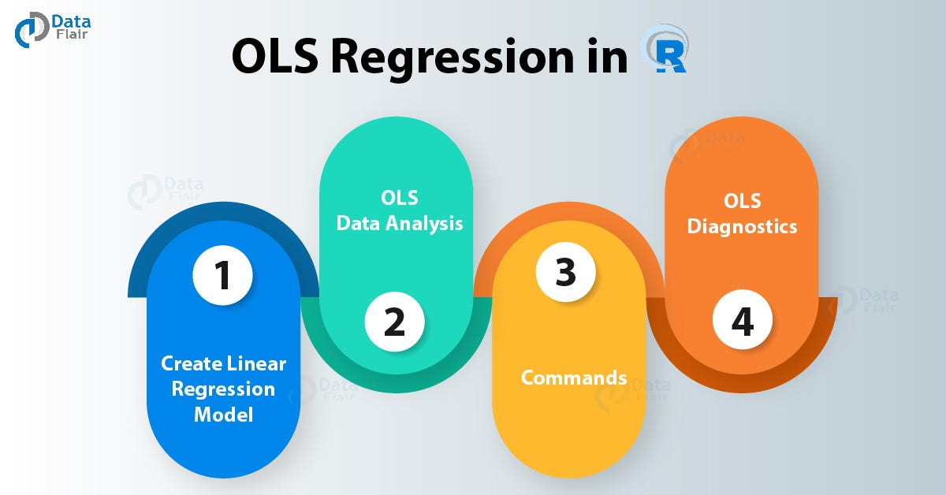
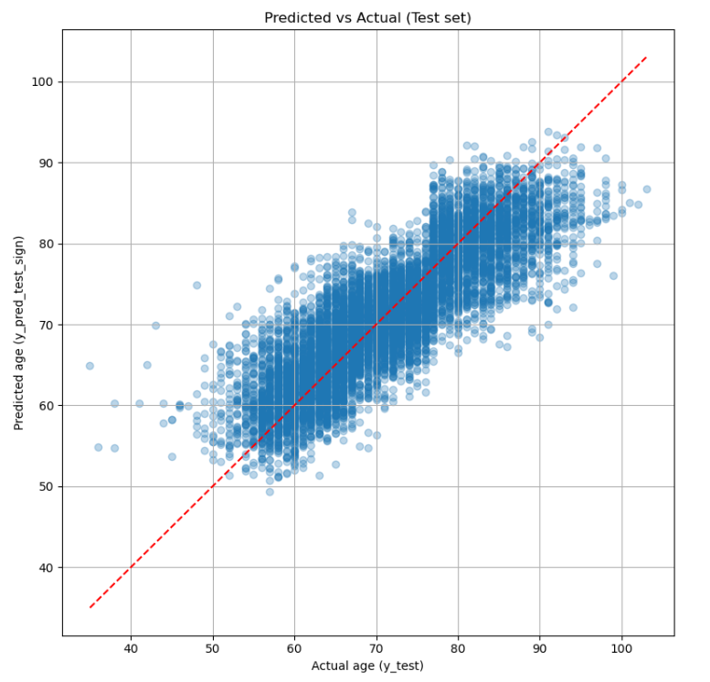
OLS Regression: Feature Selection and Collinearity Control
TEST set MAE: 3.916
TEST set MAPE: 13.25%
TEST set MSE: 25.989
TEST set R²: 0.708
TEST set Adjusted R²: 0.706
TRAIN set MAE: 3.921
TRAIN set MAPE: 5.60%
TRAIN set MSE: 26.027
TRAIN set R²: 0.711
TRAIN set Adjusted R²: 0.710

Slide 12
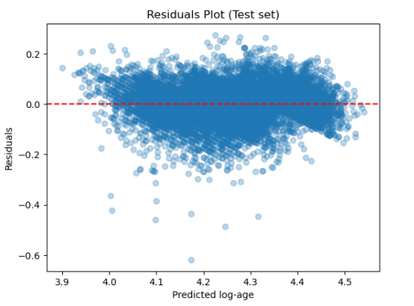
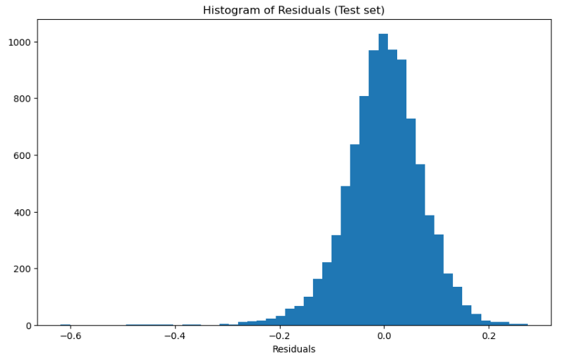
Residue diagnostics

Slide 13
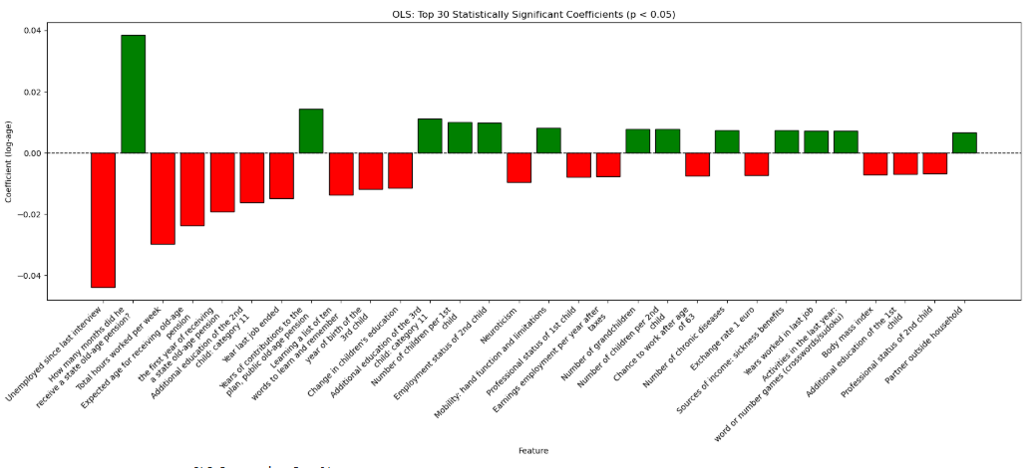

Slide 14
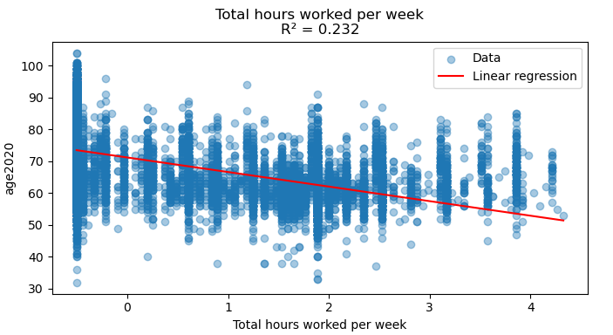
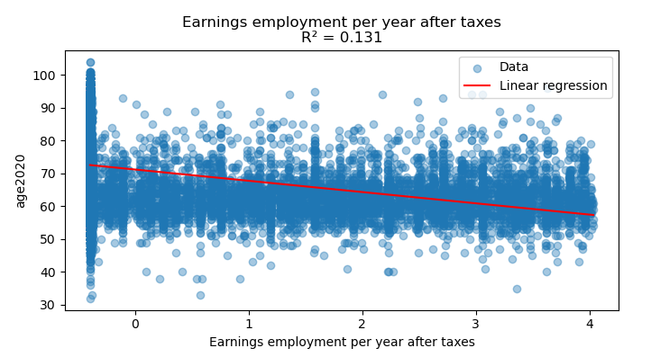
0 = 20 hours per week 1 = 30 hours per week 2 = 40 hours per week (full-time) 3 = 50 hours per week (overtime) 4 = 60 hours per week (heavy workers)
0 = 20 000 1 = 40 000 2 = 40 000 3 = 50 000
4 = 80 000

Slide 15
Variable_down | Effect_down | Label by SHARE | Variable_up | Effect_up | Label by SHARE3
ep325_ | down | Unemployed since last interview | ep208_1 | up | How many months did he receive a state old-age pension?
ep013_ | down | Total hours worked per week | ch016_1 | up | Years of contributions to the plan, public old-age pension
cf016tot | down | Learning a list of ten words to learn and remember | ch019_1 | up | Number of children per 1st child
bfi10_neuro | down | Neuroticism | chronicw8c | up | Number of chronic diseases
bfi10_extra | down | Extraversion | co002ub | up | Amount spent on food at home
ep205e | down | Earnings employment per year after taxes | ep328_ | up | Month of retirement
te035_ | down | Hours spent on paid work | ac035d9 | up | Activities in last year: did word or number games (crossword puzzles/Sudoku...)
ac035d5 | down | Hours spent on paid work | ch019_2 | up | Number of children per 2nd child
ac036_9 | down | How often did word or number games the last 12 months | ch021_ | up | Number of grandchildren
bmi | down | Body mass index | ac036_5 | up | How often gone to a sport/social/other kind of club the last 12 months
exrate | down | Exchange rate 1 euro | sn007_2 | up | Contact on social network
dn036_ | down | How many brothers alive | ep671d7 | up | Sources of income: sickness benefits
te005_ | down | Hours spent on chores | ex801_ | up | Chances to run out of money in the future
ex007_ | down | Chance government reduces pension | ch_occupation_3 | up | Professional status of the 3rd child
ep671d12 | down | Income sources: public long-term care insurance | ep671d6 | up | Sources of income: disability pension
maxgrip | down | Maximum grip strength measurement | ep649_ | up | Years worked in last job
ex009_ | down | Life expectancy | ch_outhh_receive_care_2 | up | Outside the household: assistance received from 2nd child
ep152isco | down | ISCO code: respondent's last job | ho034_ | up | Years in accommodation
dn037_ | down | How many sisters alive | ch_school_education_2 | up | School degree of child 2, based on ch017_2 & ch510_2
areabldgi | down | Area of building | ch_closeness_1 | up | Emotional closeness with 1st child
as051e | down | Amount selling cars | ep078e_1 | up | Typical old-age pension payment for last year
br003_ | down | How many years smoked | ep678e | up | Amount received from all occupational pensions last year
br006_ | down | Average amount of cigarettes per day | ft009_ | up | Received financial gift of 250 or more
hc877_ | down | Contacts specialist | ch022_ | up | Has great-grandchildren
eurod | down | Depression on the EURO-D scale | isced2011_f | up | Parent's education: Father
numeracy2 | down | Math result: subtraction | te047_ | up | Hours spent on napping and resting during daytime
hc125_ | down | Satisfaction with own coverage in basic health insurance | as070e | up | Interest or dividend income
ac036_10 | down | How often played cards or games such as chess the last 12 months | ch_closeness_3 | up | Emotional closeness with the 3rd child
ep616isco | down | Respondent's current main job | ep078e_2 | up | Typical sickness pension payment for last year

Slide 16
Outline
Introduction
The process
Final reduction of data
Drawing a conclusion
The problem
What have I learned
The solution

Slide 17
Introduction

Slide 18
The process
First contact with Share
Reading the data
Sampling the data
Deviding the dataset by feature sets
Running different models
Unsatisfactory results
New approach
Dropping features with more than 50% missing values
Reducing the data by using feature importance
Reducing the data by correlation
Excluding leaky features
Training logistic regression, random forest and decision three
Results: maximum accuracy on random forest: ~ 0.6 accuracy

Slide 19
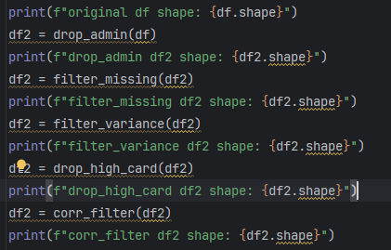

Slide 20
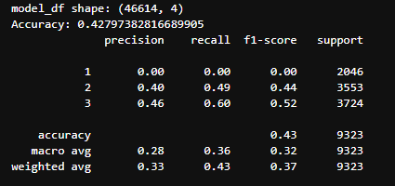

Slide 21
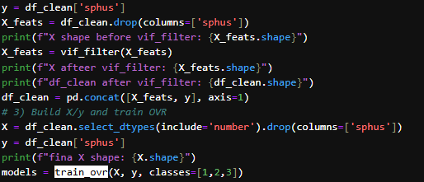

Slide 22
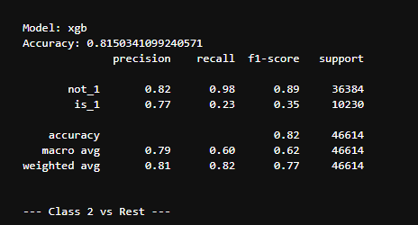
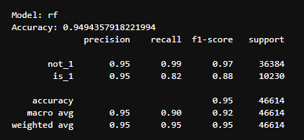
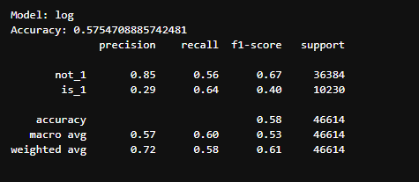

Slide 23
Reading the cookbook

Slide 24
Final reduction of data
Choosing about 1000 features, carefully evading leaky ones
Processing these features through a pipeline
Extracting the feature importance of the ~400 features left
Grouping the features in 11 cathegories
Training the model using different combinations of the groups

Slide 25
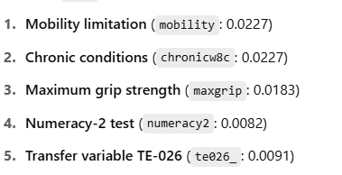
Drawing conclusions

Slide 26

Health and physical
Functional limitation and chronic desieses are the prime factor of chang in self perceived health

Slide 27

Psychological & Cognitive
Broader well-being (CASP) matters more than raw memory scores, though numeracy and loneliness also play roles.

Slide 28

Less influational domains
These domains had very small individual importances

Slide 29
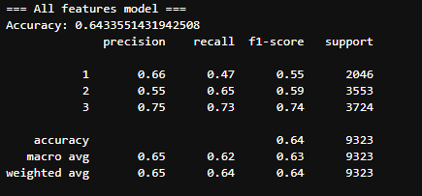
The problem

Slide 30

The solution

Slide 31
What have I learned
Without the knowledge, but with a direction
Keeping a journal/log is more important than I initially thought
Avoiding leaky feature
Feature engineering
Dimensionality reduction

Slide 32

Q & A

Slide 33
Thank you for your attention!

Slide 34

Appendix

Slide 35
List of Countries
Austria
Germany
Sweden
Netherlands
Spain
Italy
France
Denmark
Greece
Switzerland
Belgium
Israel
Czech Republic
Poland
Luxembourg
Hungary
Slovenia
Estonia
Croatia
Lithuania
Bulgaria
Cyprus
Finland
Latvia
Malta
Romania
Slovakia

